Slide 1
Control Image Captioning Spatially and Temporally
ACL 2021
Thanawan Lertmongkolnam
Neeharika Goyal
Vorapoom Thirapatarapong
Rishitha Golla
Paniti Mongkonpathumrat

Slide 2
Outlines
Introduction
Task Definition
LoopCAG Model Components
Results
Example: Comparative Case Study

Slide 3
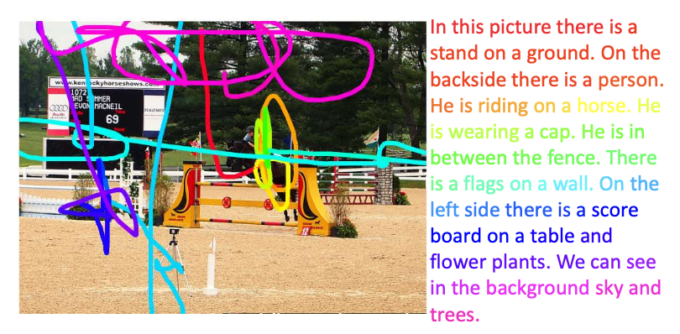
Introduction
User input : A sequence of visual elements (or "traces") associated with the image.
This paper introduces a novel model called LoopCAG;
Connects Contrastive constraints and Attention Guidance in a Loop manner.
Figure 1: Trace controlled image caption
Introduction
Task definition
LoopCAG model
Result
Comparative case study
Notes:
Image captions with user intention is an emerging need in the field of artificial intelligence and computer vision.
It involves generating a natural language description of an image by identifying its various objects, relationships, and scenes by considering user intention.
The challenge is to find an efficient way to utilize mouse traces as user input to generate high-quality and controllable image captions.
In this paper, LoopCAG model is proposed for generating captions with user intention, which takes into account the user’s input in the form of mouse traces.
This innovative approach allows users to control what to describe in the image, making the captions more personalized, and engaging.

Slide 4
Task Definition
The task is to generate a text description y given an image I.
Additional input : Sequence of tracepoints coordinates with timestamps.
Each trace segment is converted to its minimal bounding rectangle.
Every bounding rectangle can be represented by a 5D vector;
vector: normalized coordinates of the top-left and bottom-right corners, and the area ratio with respect to the whole image.
A pre-trained visual object detector : a set of visual features for each object is extracted, further to be used by the model to generate a high-quality image caption.
Introduction
Task definition
LoopCAG model
Result
Comparative case study
Notes:
The task is to generate a text description given an image, and for trace-controlled image captioning, the input is a sequence of trace points coordinates with timestamps. The visual object detector is used to extract object-level visual features from the image to create the object level visual feature set V. The text description sequence is represented by y, and the trace input is represented by T. The goal is to generate a text description that combines both the visual features of the image and the trace input.
The trace controlled captioning objective can be formulated as follow:
θ∗ = argmaxlogp(y | V ,T;θ)

Slide 5
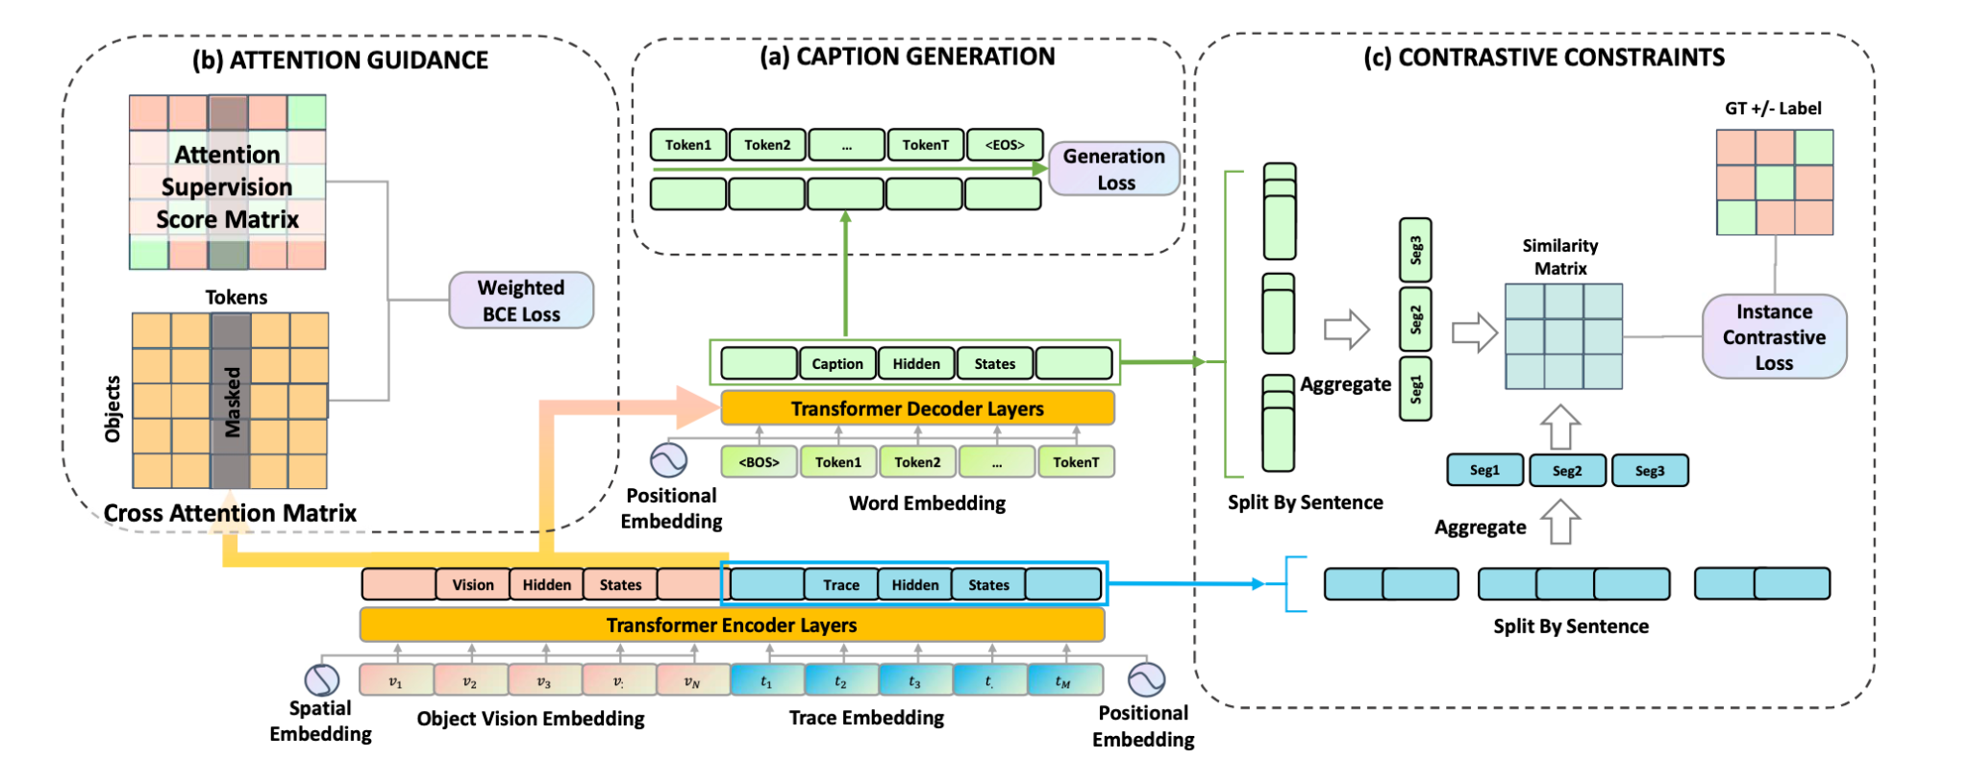
LoopCAG’s Model Components
Caption Generation – Transformer-based encoder-decoder
Encoder: takes Vision and Trace embeddings, concatenated together as input
Decoder: generates caption tokens using vision and trace information from the hidden state of the encoder’s last layer
Introduction
Task definition
LoopCAG model
Result
Comparative case study
Notes:
There are 3 components in the proposed LoopCAG model: caption generation (base model), attention guidance (AG), and contrastive constraints (C). AG and C are added to LoopCAG and makes it SOTA
The caption generation part is a transformer-based encoder-decoder which uses the multi-head attention mechanism
On the encoder side, there are 2 parts of input: vision embeddings and trace embeddings. These 2 are concatenated together before passed to the encoder.
On the decoder side, it uses the hidden states of the encoder and generates the caption tokens as output

Slide 6
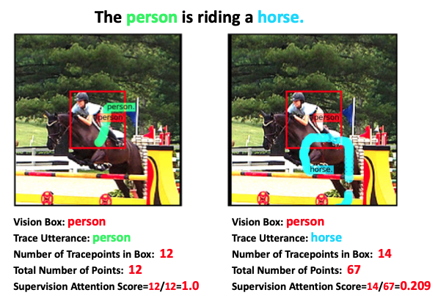
LoopCAG’s Model Components
Attention Guidance – for spatial ground attention supervision construction
Language-trace temporal alignment
Language-vision spatial alignment
Introduction
Task definition
LoopCAG model
Result
Comparative case study
Notes:
1) The authors leveraged the information in the dataset by aligning each tracepoint to a unique utterance. (utterance = a phase used to describe a part of the image)
Then, every utterance is aligned to a series of tracepoints
2) The idea is to calculate the alignment score considering the spatial overlap between tracepoints and each vision object
Then, we have a heuristic supervision attention score matrix that can be used to supervise the vision-linguistic cross-attention
Aligns the caption tokens and visual objects spatially
Second component is the attention guidance which is used to aligns the caption tokens and the visual objects in the image spatially
?? Skip the explanation of the 2 matrices in the diagram as it might lead to confusion because of complex methodology
Attention Supervision matrix - uses traces as a bridge to align captions and objects in the image, the value in the matrix is the alignment score of the word/utterance u_i and the bounding box b_i (value = 1 if word/utterance is within the box)
Cross attention matrix is generated from step1’s decoder

Slide 7
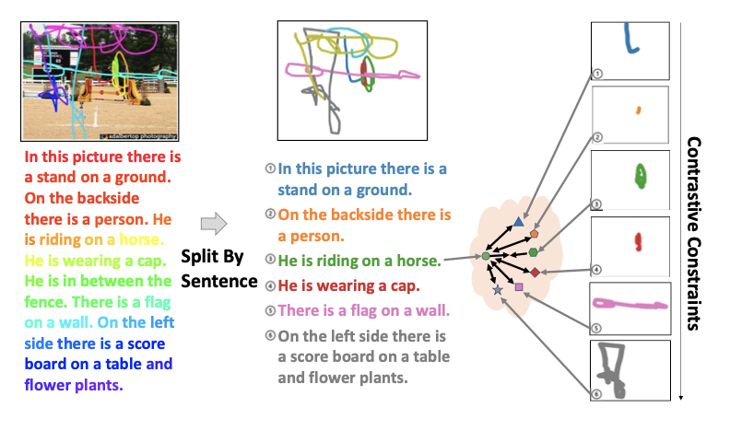
LoopCAG’s Model Components
Contrastive Constraints – for temporal alignment
Split by Sentence – build a sentence-level alignment between caption and traces
Train to make a correct temporal alignment between each corresponding caption sentence and trace segment pairs
Introduction
Task definition
LoopCAG model
Result
Comparative case study
Notes:
split the instance by sentence. This will output pairs of caption sentence and the trace segment
train to make a correct temporal alignment between each corresponding caption sentence and trace segment pairs
The third component is the Contrastive Constraints which is used to align the captions with the traces temporally
2 main steps in this part is to first split the instance by sentence (right pic). This will output pairs of caption sentences and the trace segment
Next step is to train to make a correct temporal alignment between each corresponding caption sentence and trace segment pairs

Slide 8
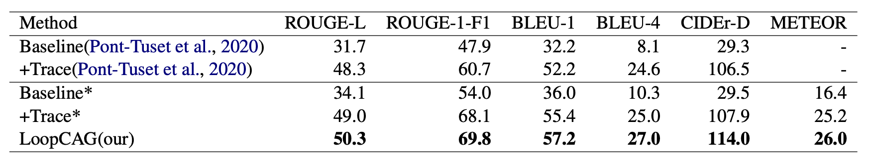
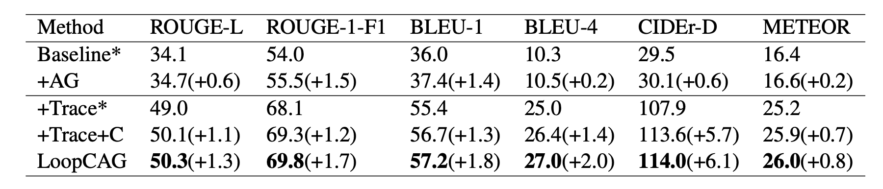
Results
Better alignment to the user intent in terms of the order of generated sentence
More precise caption
Table 1: Comparing with baseline methods
Table 2: Ablation Study results
Improvement
Introduction
Task definition
LoopCAG model
Result
Comparative case study
Notes:
Table 1
The model demonstrates superior capability on captioning quality according to BLEU-4 and CIDEr-D metrics
Also, we found that the model can better align the order of generated sentence to the user intent according to ROUGE-L
Besides how precise the model is, the other two main advantages of this model are the controllability and explainability
contrastive constraints can help the model better align the order of generated sentence to the user intent because ROUGE-L mainly employs an order mattered longest common sequence F-measure.
Table 2
The authors tried to make sure that the improvement indeed came from the Attention Guidance, the Trace Feature, and the Contrastive Constraints
Table 1: definition of each method: Baseline means an encoder-decoder model without taking trace as input. +Trace means concatenating encoded trace feature to the encoder input, i.e., trace controlled caption performance. LoopCAG is our complete model. The results with * are the baseline performance re-implemented by ourselves
Compared to Baseline* method, the performance on all metrics improves significantly when controlling captioning using the mouse trace (+Trace*), it indicates that using the mouse trace enables the system to describe better those user intended parts of the image.
LoopCAG method outperforms the previous state-of-art model which is +Trace by 2.4 and 7.5 on BLEU-4 and CIDEr-D, respectively. This demonstrates Attention Guidance method helps the model generate better spatially grounded and more precise captions.
When considering the 2.0 rising on ROUGE-L score, we can conclude that Contrastive constraints can help the model better align the order of generated sentence to the user intent because ROUGE-L mainly employs an order mattered longest common sequence F-measure.
Table2: +C means applying the contrastive constraints method.
We perform three ablations to verify the most improvements indeed come from the Attention Guidance and Contrastive constraints. We add the Attention Guidance to help the model better spatially ground visual objects and caption tokens (Table 2, “+ Ag”). This suggested that model does benefit from knowing where to find the highly semantic related appearance feature in the image.
Next, we add the trace feature (Table 2, “+ Trace”). This introduces user intention to the model. We also take this line to show the performance lift caused by Contrastive constraints fairly.
Then we add the contrastive module (Table 2, “+C”) and see a good improvement on almost all criteria.
Hence, we verify the significance of the positive influence of temporal contrastive constraints. Moreover, in the last line is our full LoopCAG model. We can see the two proposed methods are not exclusive to each other.

Slide 9
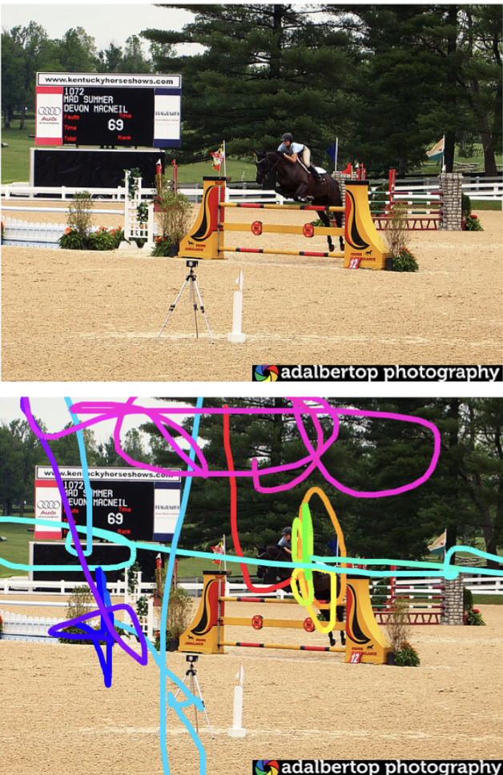
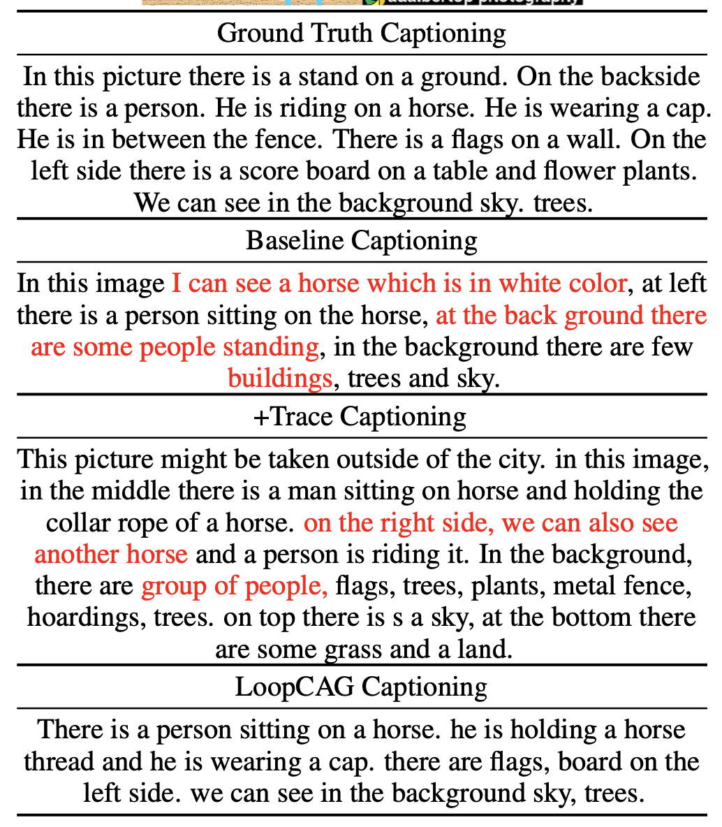
Comparative Case Study
LoopCAG has the same order as Ground Truth Captioning
LoopCAG is more reasonable than Baseline Captioning and +Trace Captioning
Introduction
Task definition
LoopCAG model
Result
Comparative case study
Notes:
We can easily find that the Baseline captioning describes the image in random order
+Trace Captioning and LoopCAG Captioning almost have the same order as Ground Truth Captioning.
Baseline captioning and +Trace Captioning both consist of some preposterous description highlighted in red color, while the LoopCAG captioning is all reasonable. This is evidence of superior fact grounding advantage brought by our Attention Guidance Method.

Slide 10
Thank you

Slide 11
Appendix

Slide 12
Datasets
Annotated COCO subset of Localized Narratives was used.
Each image has one or several pairs of the captioning paragraph and corresponding mouse traces.
This data split is shortly called as LN-COCO.
Every single pair is called Localized Narrative.
Training set contains 134,272 localized narratives and validation set contains 8,573.

Slide 13
Evaluation Metrics
Traditional image captioning evaluation metrics like BLEU, METEOR, ROUGE-L, Rouge-1-F1, CIDEr-D were used with minor modifications.
BLEU measures the quality of generated captions by comparing with one or more human generated captions of that image.
METEOR (metric for evaluation of translation with explicit ordering) is similar to BLEU but it handles synonyms and paraphrases more efficiently than BLEU.
ROUGE-L(Recall Oriented Understudy for Gisting Evaluation-Longest common sequence) captures similarities between the candidate and reference summaries even when the words and phrases used are not identical.
ROUGE-1-F1 evaluates the quality of generated texts, particularly when there is a need to evaluate the ability of a system to capture the main ideas of a text at the word level.
CIDEr-D(Consensus based image description evaluation) measures the similarity of a generated sentence against a set of ground truth sentences written by humans, which is trying to solve the problem of weak correlation between the previous metrics and human judgement.

Slide 14
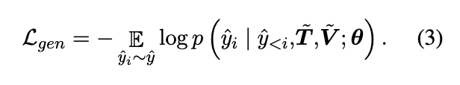
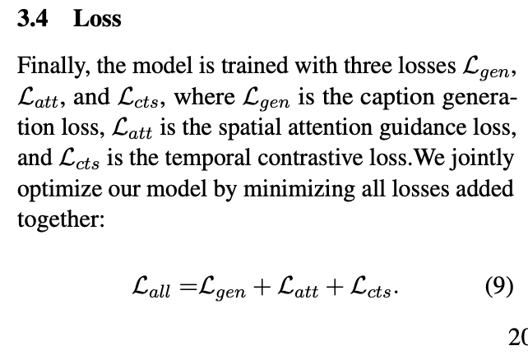
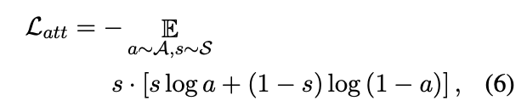
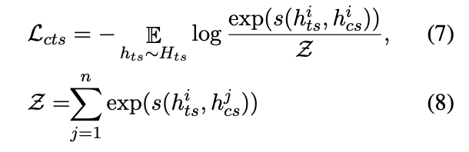
Model’s losses

Slide 15
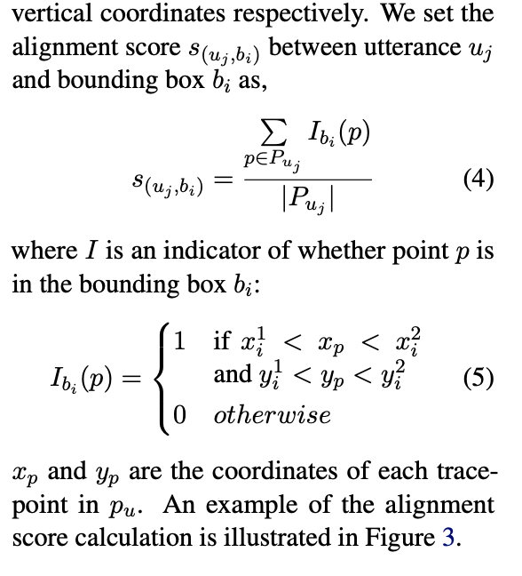
Attention Supervision scores

